Slide 1
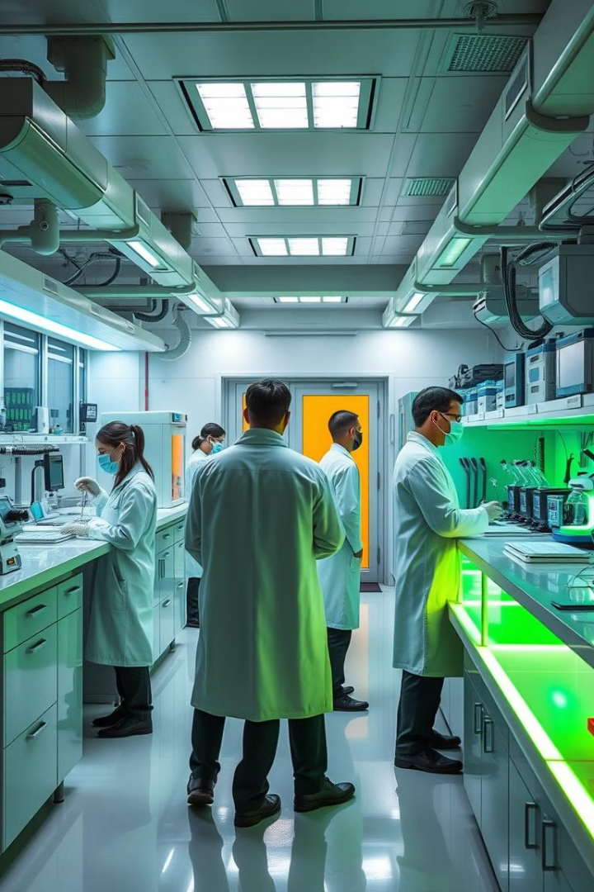

Innovating with AI-ML in Biotechnology
Biotechnology is at the forefront of innovation, harnessing the power of AI and machine learning to unlock groundbreaking discoveries and solutions. This transformative approach combines data-driven insights with generative AI models to address complex challenges in the field.
by K N S Sri Harshith

Slide 2
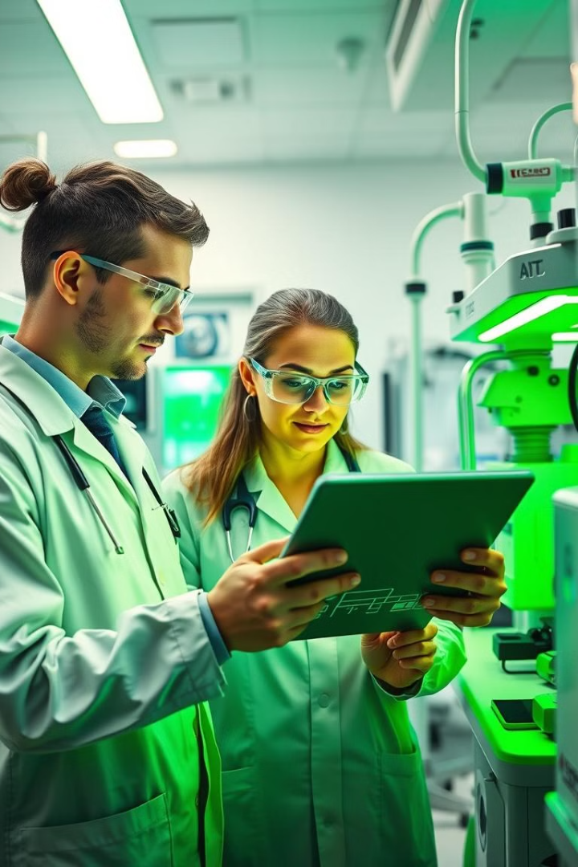
Identifying a Specific Problem or Need
1
Understand the Challenge
2
Research and Gather Data
Start by deeply understanding the specific problem or unmet need within biotechnology that your AI-powered solution aims to address.
Collect relevant data and insights from various sources to inform your understanding of the problem and guide your solution development.
3
Prioritize Impact
Focus on addressing an issue that can have a tangible, meaningful impact on individuals, healthcare systems, or the broader biotechnology landscape.

Slide 3
Leveraging Biotech Data and Insights
Data Mining
Predictive Modeling
Generating Insights
Utilize advanced data mining techniques to uncover hidden patterns, trends, and relationships within your biotech data.
Apply machine learning algorithms to develop predictive models that can forecast outcomes, behaviors, or potential breakthroughs.
Transform data into actionable insights that can inform your AI-powered solution and drive meaningful impact.

Slide 4
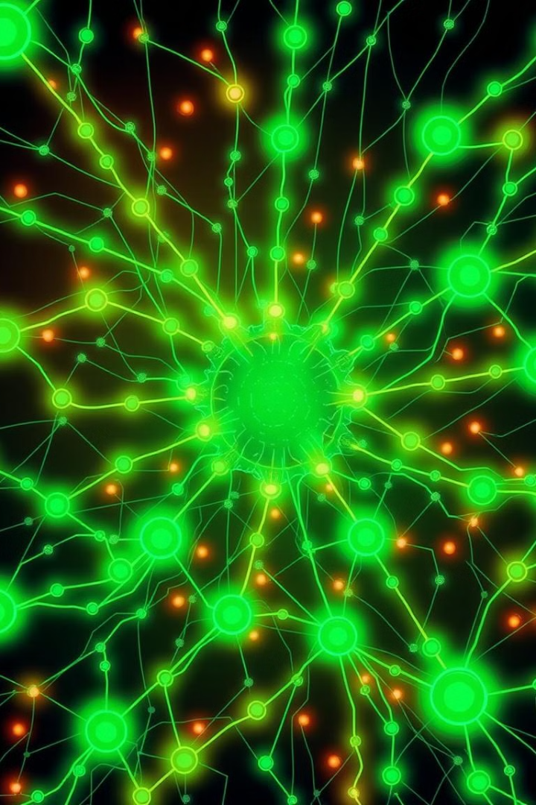
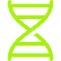



Harnessing the Power of Generative AI
Genomics
Imaging
Generate novel genomic sequences, predict protein structures, and explore genetic variations.
Enhance medical imaging, segment anatomical structures, and generate synthetic data for training.
Drug Discovery
Clinical Insights
Design new drug candidates, optimize molecular properties, and accelerate the drug development process.
Predict disease trajectories, personalize treatment plans, and support clinical decision-making.

Slide 5
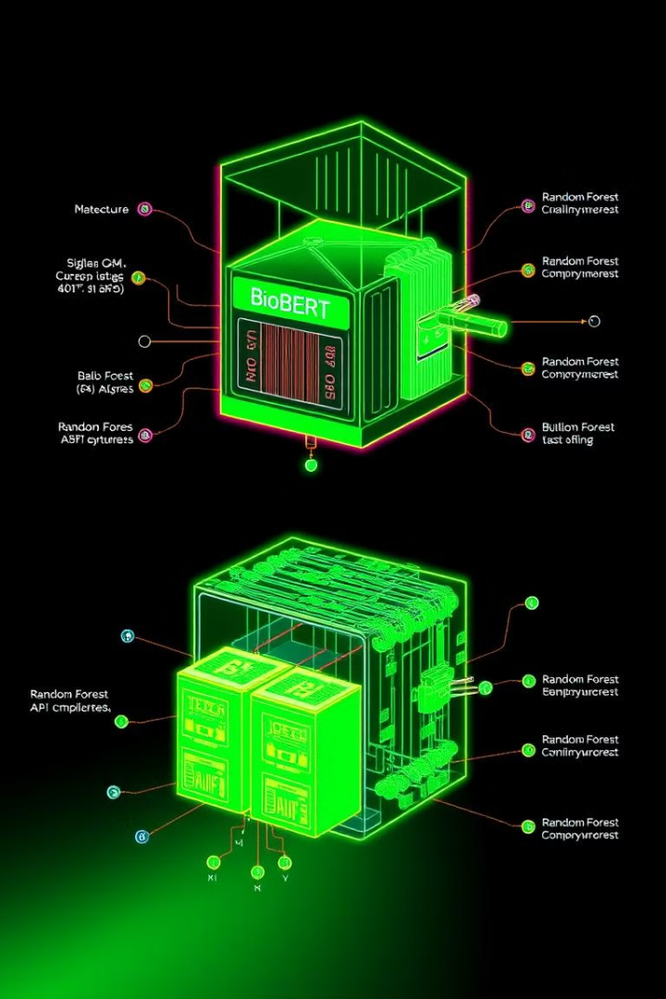
Introducing BioBERT and Random Forest
1
BioBERT
A pre-trained language model fine-tuned on biomedical text data, enabling advanced natural language processing capabilities.
2
Random Forest
An ensemble machine learning algorithm that excels at classification and regression tasks, providing robust and interpretable results.
3
Integrating the Models
Combine the strengths of BioBERT and Random Forest to create a powerful AI-powered solution for your biotechnology application.

Slide 6
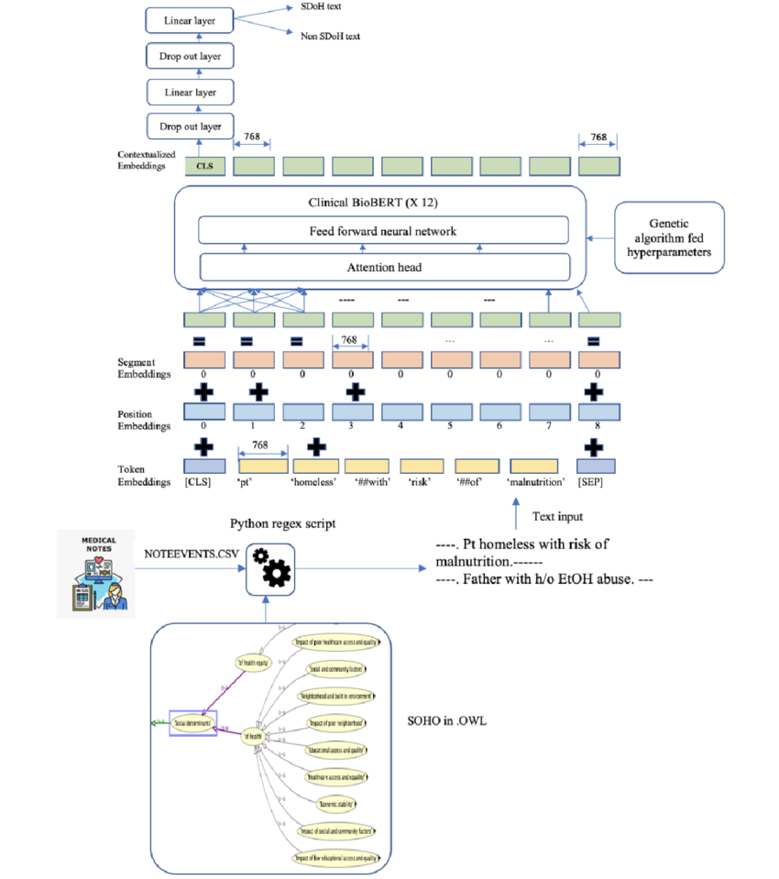
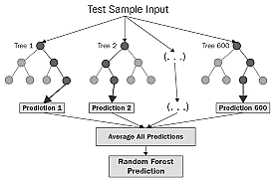

Slide 7
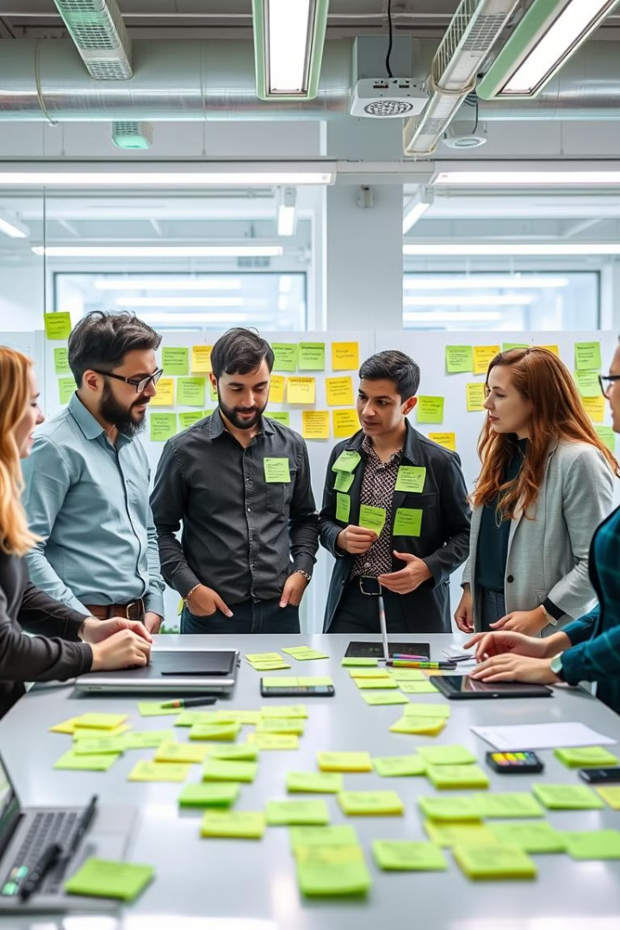
Designing a Tangible, Impactful Solution
Personalized Wellness Plans
Predictive Healthcare
Leverage AI-generated insights to create customized wellness programs that consider an individual's unique health data and goals.
Develop models that can forecast disease trends, identify high-risk individuals, and guide proactive interventions.
Optimized Drug Discovery
Automated Diagnostics
Accelerate the drug development process by using generative AI to design and evaluate new drug candidates.
Leverage computer vision and deep learning to automate the analysis of medical images and lab results.

Slide 8




Addressing Individual or Systemic Needs
Individual Impact
Systemic Transformation
Collaborative Approach
Design solutions that empower individuals to take charge of their health and well-being, providing personalized insights and support.
Develop AI-powered tools and platforms that can streamline healthcare processes, optimize resource allocation, and improve outcomes at a population level.
Foster interdisciplinary partnerships and engage diverse stakeholders to ensure your solution addresses the needs of both individuals and healthcare systems.

Slide 9
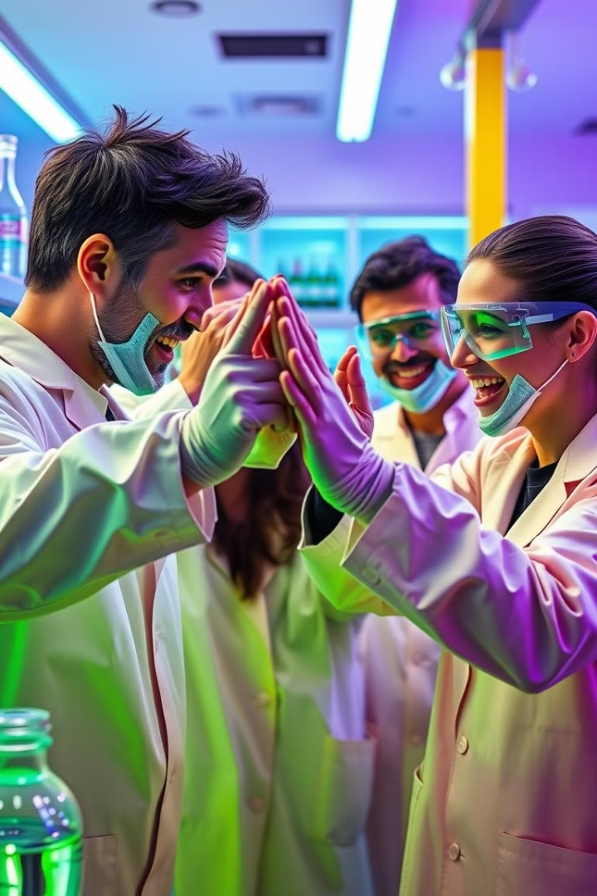
Conclusion and Next Steps
Embracing the power of AI-ML in biotechnology opens up a world of possibilities to drive innovation, improve healthcare, and transform lives. By identifying specific needs, leveraging data-driven insights, and harnessing the potential of generative AI models, you can create impactful, tangible solutions that make a difference.

